Slide 1


Basic String Functions in SQl
Fundamentals and Background
Notes:
String Functions are a way of changing a string as an output. There are basic string functions in SQL you should know.

Slide 2
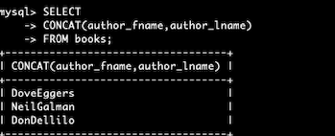
String Functions
concat combines data for better output. The syntax is:
select concat (<column>, <another column>) from <tablename>;
For example:
Notes:
concat combines data for better output. The syntax is: select concat (<column>, <another column>) from <tablename>;

Slide 3
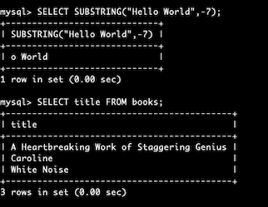
String Functions (count.)
substring works with parts of strings. The syntax is:
select substring (<column>, <another column>) from <tablename>;
For example:
Notes:
substring works with parts of strings. The syntax is: select substring (<column>, <another column>) from <tablename>;

Slide 4
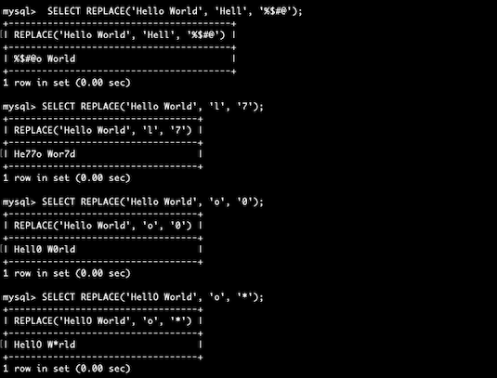
String Functions (count.)
replace replaces parts of strings. The syntax is:
replace (<string>, <old string>, < new string>);
For example:
Notes:
replace replaces parts of strings. The syntax is: replace (<string>, <old string>, < new string>);

Slide 5
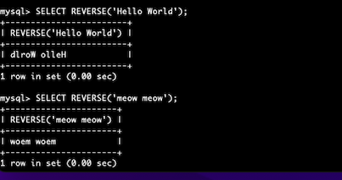
String Functions (count.)
reverse reverses parts of strings. The syntax is:
select reverse (<string>);
For example:
Notes:
reverse reverses parts of strings. The syntax is: select reverse (<string>);

Slide 6
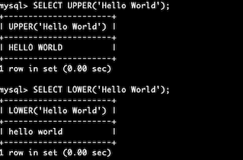
String Functions (count.)
upper and lower changes a string’s case. The syntax is:
select upper or lower (<expression>) from <tablename>;
For example:
Notes:
upper and lower changes a string’s case. The syntax is: select upper or lower (<expression>) from <tablename>;

Slide 7
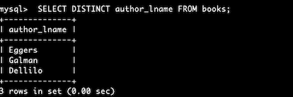
String Functions (count.)
distinct returns unique values. The syntax is:
select distinct <column name> from <tablename>;
For example:
Notes:
distinct returns unique values. The syntax is: select distinct <column name> from <tablename>;

Slide 8
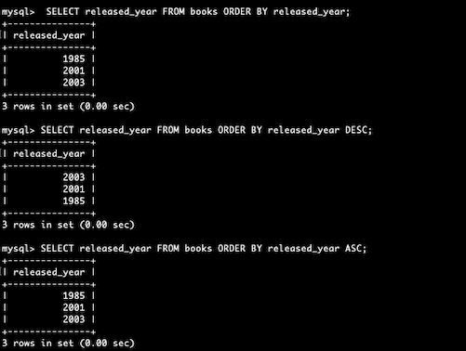
String Functions (count.)
order by orders results. The syntax is:
select <column name> from <tablename>
order by <column name>;
For example:
Notes:
order by orders results. The syntax is: select <column name> from <tablename> order by <column name>;

Slide 9
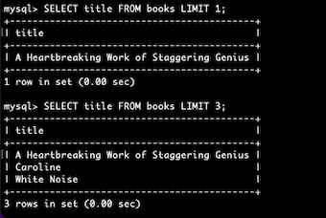
String Functions (count.)
limit limits results. The syntax is:
select <column name> from <tablename>
limit <expression>;
For example:
Notes:
limit limits results. The syntax is: select <column name> from <tablename> limit <expression>;

Slide 10
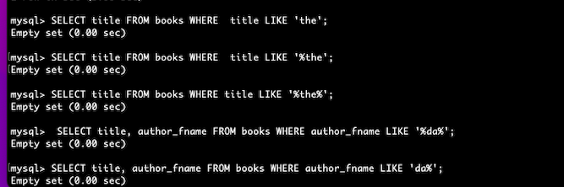
String Functions (count.)
like helps you with better searching The syntax is:
select <column name> from <tablename>
where <column name> like <pattern>;
For example:
Notes:
like helps you with better searching The syntax is: select <column name> from <tablename> where <column name> like <pattern>;

